Slide 1
Govtech TAP OA
Lee Gene Ee

Slide 2
Question 1 – HDB Flats
Format:
Each slide would contain the chart and derivations for the public. The speaker notes will state the exact steps taken to get the figure / explain the figure more in depth.
Focus:
Impact on Agent activity
Impact on Agent revenue

Slide 3
Agent activity

Slide 4
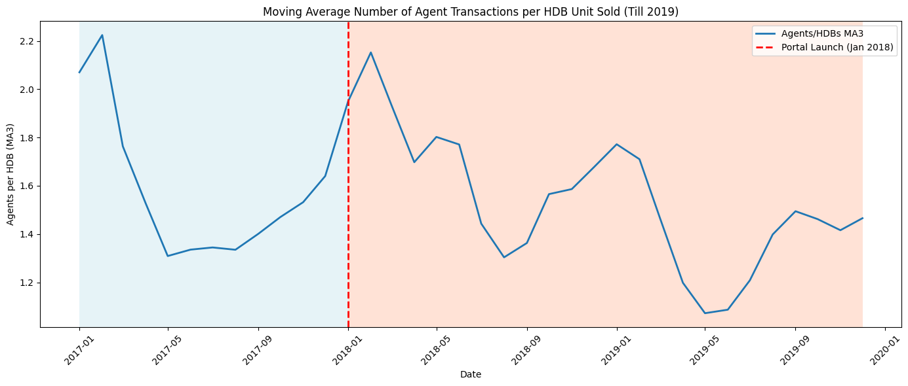
AGENTS USAGE PER HDB transaction
Notes:
This chart shows the ratio of agent-handled transactions relative to the total number of HDB flats sold. A higher ratio indicates that more agents were involved in facilitating transactions during that period.
The time window is capped at 2020 to keep the comparison focused and avoid an overly long horizon, which can make trends harder to judge.
A 3-month moving average is used instead of absolute monthly values to smooth out short-term fluctuations and seasonality, making underlying trends easier to interpret.
From this chart, there is no clear evidence that the introduction of the portal in January 2018 had a significant impact on agent involvement. The ratios fluctuate over time, but without a consistent upward or downward trend directly attributable to the policy change.

Slide 5
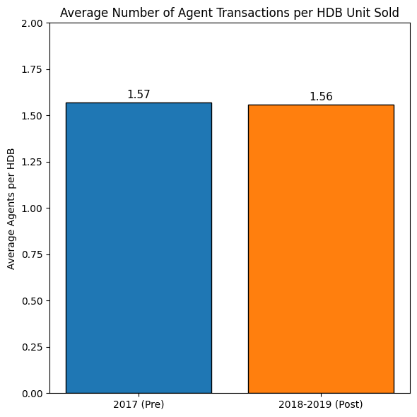
Agents usage per HDB transaction
Before the portal was launched, there were slightly more agents were involved on average per HDB flat transacted.
However, the difference is only 0.01 between pre and post portal
Highlights that there isn’t a negative impact on the agent’s activity due to the portal introduction

Slide 6
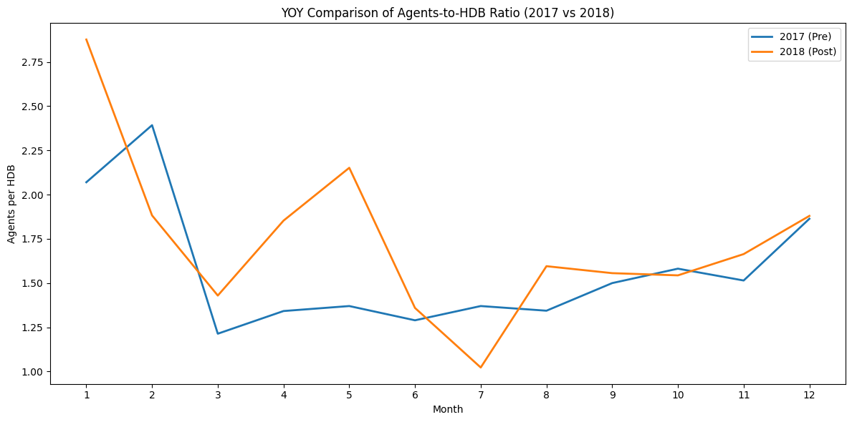
comparison OF agents usage per hdb transaction
No significant difference in agent-to-HDB transaction ratio pre- and post-portal, after accounting for seasonality
Highlights that agents continue to handle a similar number of transactions as before the portal launch

Slide 7
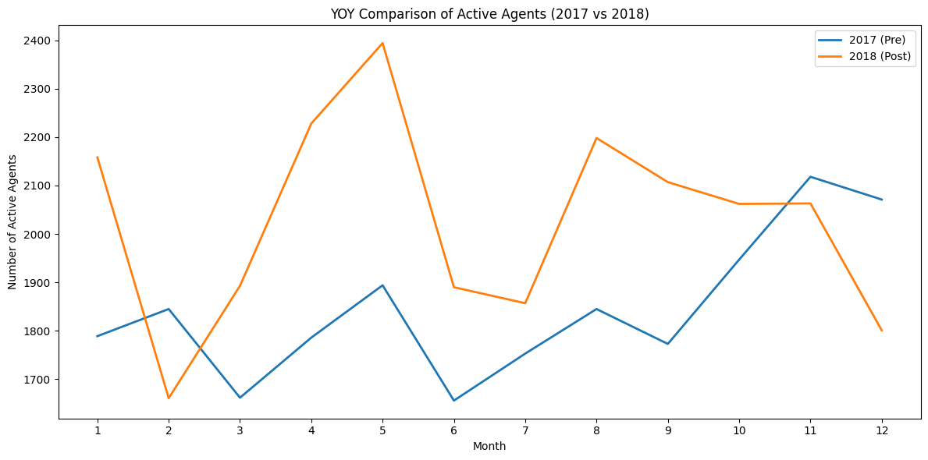
comparison OF Active agents
After accounting for seasonality, no evidence of a negative impact on agents’ business year-on-year
Agent activity shows slightly higher engagement from March to October, rather than a decline

Slide 8
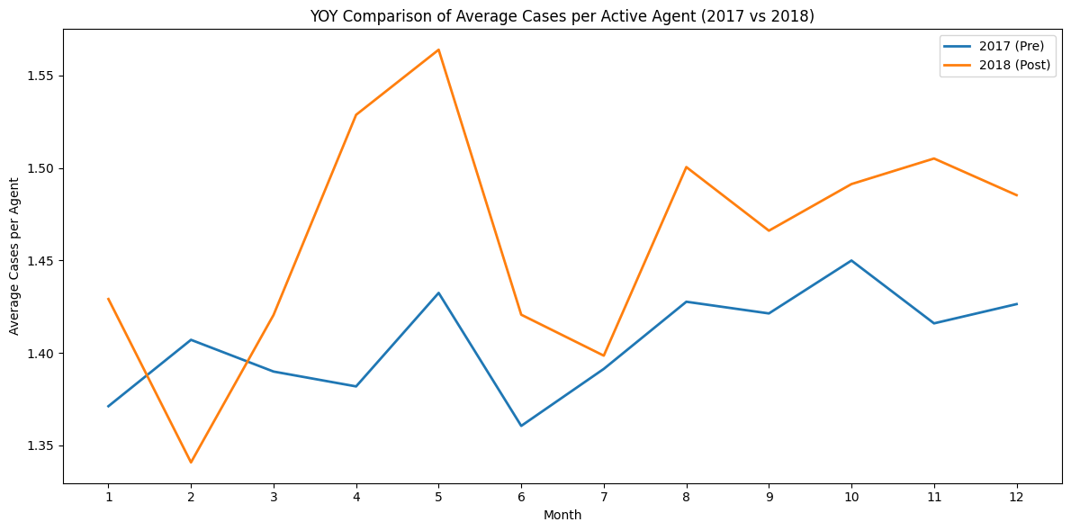
comparison of Average cases per agent
After accounting for seasonality, no significant decrease in agent business.
On the contrary, more cases handled on average, with 11 out of 12 months in 2018 exceeding 2017 levels

Slide 9
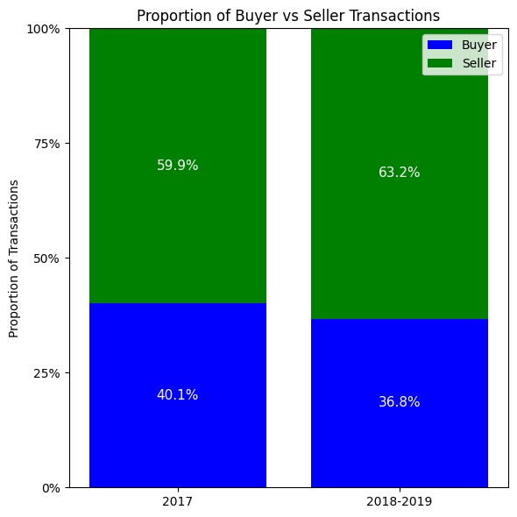
Comparison of transaction types
Transaction type analysis shows little change in agent utilization after the portal
Slight increase in agents used for selling (from 59.9% → 63.2%) and decrease for buying (40.1% → 36.8%)
Overall ratio remains fairly consistent, indicating minimal impact

Slide 10
Conclusion – agent activity
Overall, the introduction of the HDB portal does not appear to have significantly impacted agent activity negatively.
Agent involvement, both in total transactions and by transaction type, remains largely consistent, with only minor variations observed across months and years.
Slight increase in agent activity (Agent usage per HDB flat transacted) could be attributed to other reasons, such as increased branding and trust in established real estate agencies.

Slide 11
Agent Revenue

Slide 12
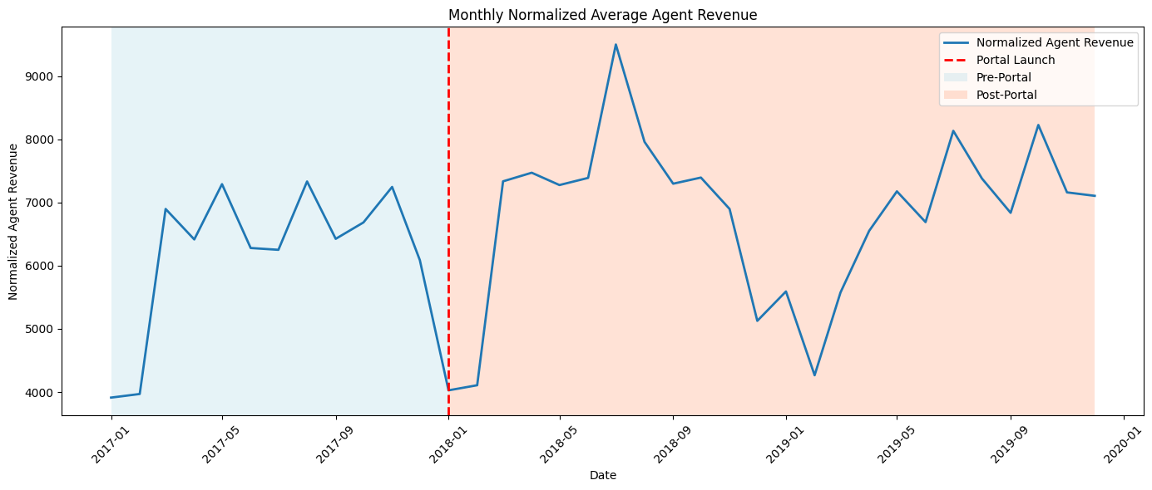
Agent revenue per month
Notes:
Average agent revenue is estimated by multiplying the median price of HDB flats transacted by the applicable commission rate (2% for selling, 1% for buying).
The median is used instead of the mean to reduce the effect of extremely high-priced flats.
This is a proxy estimation, as exact transaction types and prices are not fully available.
The revenue is further normalized by the total sales revenue of all HDB flats in the month to account for changes in transaction volume.
The chart shows fluctuations in estimated agent revenue both before and after the portal launch, but no clear trend is observed.

Slide 13
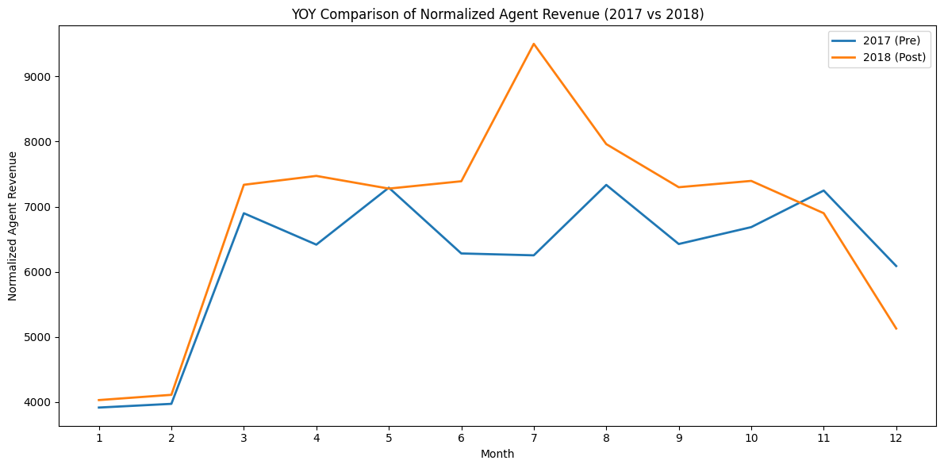
Yoy comparison of agent revenue
After estimating average agent revenue and normalizing it by total HDB sales revenue per month (to isolate changes in agent earnings from overall market growth), we observe that year-on-year differences are generally small.
Interestingly, agents earned noticeably more in June and July following the portal launch

Slide 14
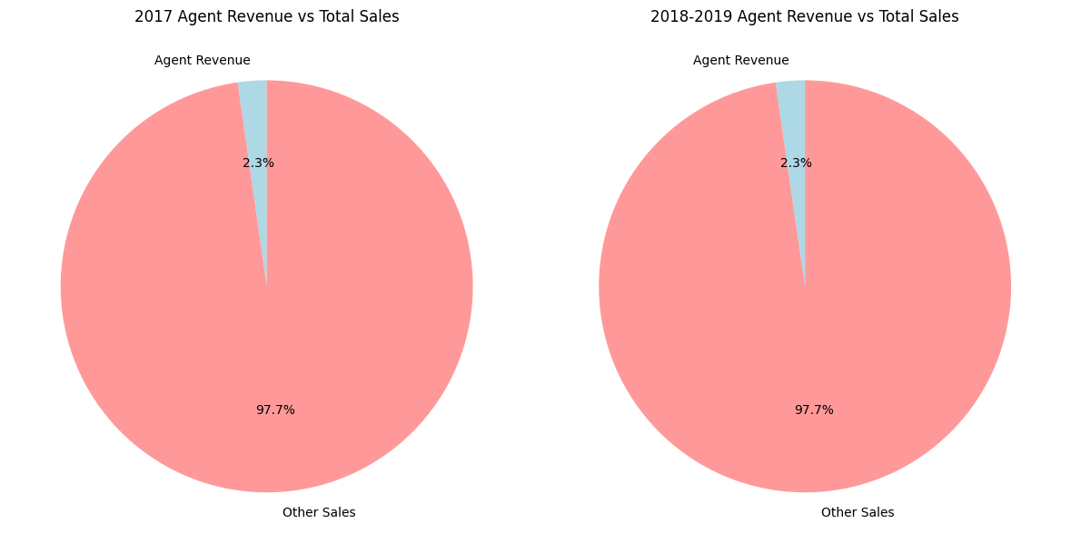
Agent revenue
Notes:
Agent revenue as a part of total HDB sales is estimated by applying commission rates of 2% for selling and 1% for buying to the median resale price of flats (used as a proxy to reduce skew from expensive flats).
Total sales is the actual transacted amount of all resale flats.
As shown, the agent revenue proportion remains fairly constant at around 2.3%, indicating that the portal does not have a significant impact in this aspect.

Slide 15
Conclusion
There is no strong evidence that the portal has caused agents businesses to take a hit from their activity and revenue metrics
In fact, there is a slight increase YOY for activity and revenue metrics, meaning agents are doing more HDB resale transactions and also earning more
Hence, there is no negative impact / negligible impact on Agent’s businesses due to the introduction of the portal
Instead, slight increase might have occurred due to reasons such as increased branding and trust in established real estate agencies.

Slide 16
Question 2 – CMC settlements
Prediction Model training process
Testing Architectures
Imbalance strategies
Optimising hyperparameters and training
Training results
Proposed Deployed Flow
Example screenshots
Live website deployed: https://gtech2025.streamlit.app/

Slide 17
Model 1 – Testing architectures
Model | ROC-AUC | Selected
LightGBM | 0.748270 | No. Reason is below.
XGBoost | 0.746169 | Yes. Only slight drop in ROC-AUC (~0.002). However, XGBoost is a familiar architecture that has wide support in deployment environments. Level-wise approach might make it more effective against overfitting too.
MLP | 0.742134 | No. Lower ROC-AUC, as well as more extensive resources for training.
Random Forest | 0.739361 | No. Poorer performance.
SVM | 0.737889 | No. Poorer performance.
Logistic Regression | 0.671224 | No. Poorer performance.

Slide 18
Model 1 – Imbalance strategies
Class distribution
1: 4417 -> 61.41%
2: 2776 -> 38.60%
Slight class imbalance
Method | ROC-AUC | Selected
None | 0.736263 | Yes. Best performance.
Scale_Pos_Weight - Scale loss function to force algorithm to focus on misclassifications of less frequent classes | 0.735924 | No. This result shows that the class imbalance is not as severe to a point where scale_pos_weight helps with training.

Slide 19
Model 1 – Final result
Final Optimized hyperparameters (Changes every iteration)
n_estimators: 149
max_depth: 7
learning_rate: 0.27
subsample: 0.68
colsample_bytree: 0.87
gamma: 0.02
reg_alpha (L1 Regularization): 2.93
reg_lambda (L2 Regularization): 2.09
Final F1-score
Macro-average: 0.70 (Use this as it accounts for class imbalance)
Weighted-average: 0.72

Slide 20
Model 2 – Testing architectures
Model | ROC-AUC | Selected
XGBoost | 0.653620 | Yes. Best performance and familiar architecture for deployment.
RandomForest | 0.651961 | No. Poorer performance.
LightGBM | 0.649656 | No. Poorer performance.
MLP | 0.637358 | No. Poorer performance.
LogisticRegression | 0.571554 | No. Poorer performance.
SVM | 0.459864 | No. Poorer performance.

Slide 21
Model 2 – Imbalance strategies
Class distribution
1: 2069 -> 74.5%
2: 707 -> 25.4%
Moderate Class imbalance
Method | ROC-AUC | Selected
Undersample | 0.612559 | Yes. Best performance.
Scale_Pos_Weight | 0.610321 | No. Poorer performance.
none | 0.607411 | No. Poorer performance.
Oversample | 0.601053 | No. Poorer performance.

Slide 22
Model 2 – Final result
Final Optimized hyperparameters (Changes every iteration)
n_estimators: 235
max_depth: 6
learning_rate: 0.036
subsample: 61
colsample_bytree: 0.84
gamma: 0.07
reg_alpha (L1 Regularization): 0.61
reg_lambda (L2 Regularization): 2.60
Final F1-score
Macro-average: 0.55 (Use this as it accounts for class imbalance)
Weighted-average: 0.59

Slide 23
Proposed Deployed flow
Features
is_weekend
Intake_type
Dispute_type
Display warning, may try mediation determining on circumstances + settlement chances
Model 2
Predict probability of successful settlement – P2
P1 < 0.50
Model 1
Predict probability of turning up for mediation – P1
LabelEncoder
Pretrained on given dataset
For Intake_type and Dispute_type
P1 > 0.40
P1 > 0.50
Display should mediate + settlement chances
P1 < 0.40
Display low chance of mediation

Slide 24
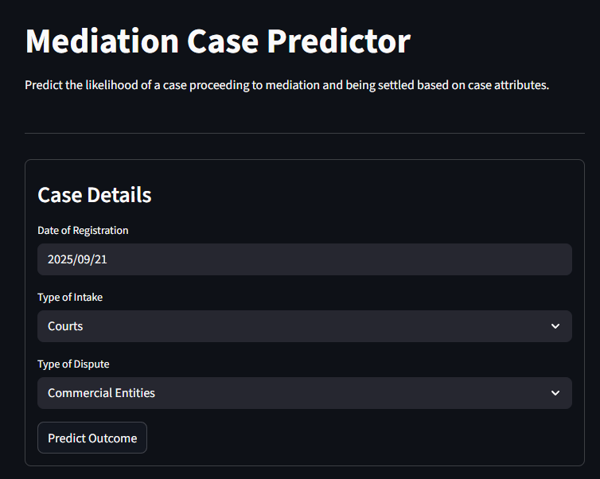
Walkthrough – input details
Website: https://gtech2025.streamlit.app/
Input details Page

Slide 25
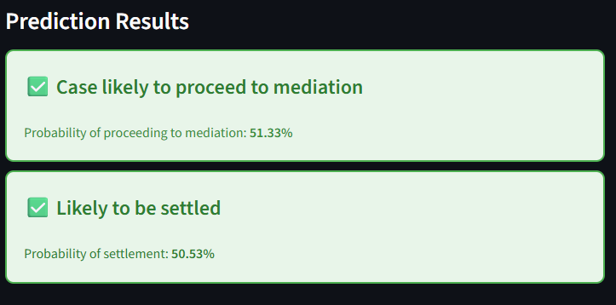
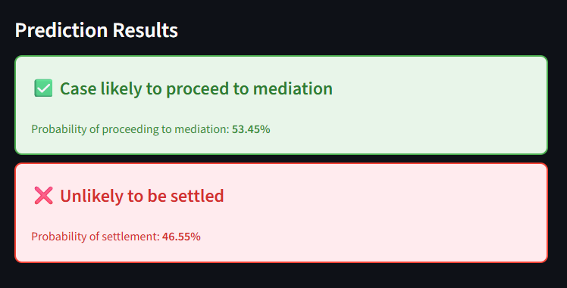
Walkthrough - Example outputs
Case | Output
P(Mediation) > 0.50 P(Settlement) > 0.50
P(Mediation) > 0.50 P(Settlement) < 0.50

Slide 26
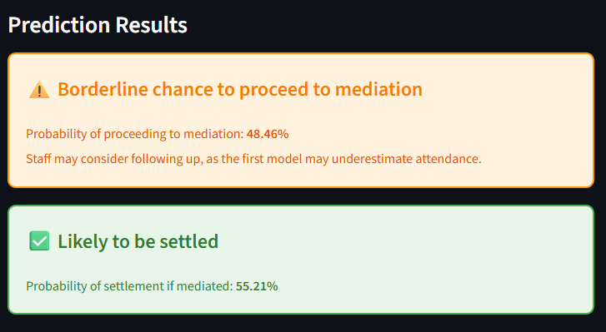
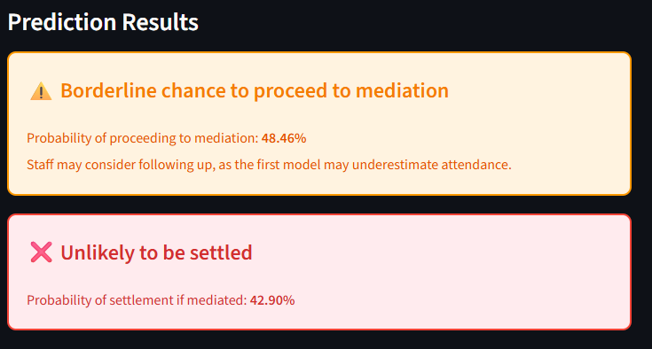
Walkthrough - Example outputs
Case | Output
0.50 >= P(Mediation) >= 0.40 P(Settlement) > 0.50
0.50 >= P(Mediation) >= 0.40 P(Settlement) < 0.50

Slide 27
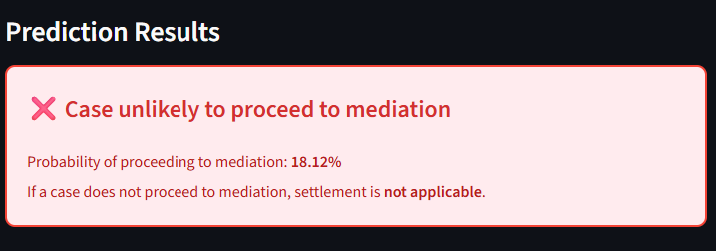
Walkthrough - Example outputs
Case | Output
P(Mediation) < 0.40

Slide 28
Conclusion
Final result for Models
Both utilize XGBoost, and are optimised + handled for class imbalance
Mediation model: Macro-average F1: 0.70
Settlement model: Macro-average F1: 0.55
Additional warning sign (0.40 <= P(mediation) <= 0.50) is used as:
To prevent compounding error if Mediation model is wrong
Leave more flexibility and transparency to the user
Probability is displayed to show user how confident the model is, so CMC staff have full transparency and confidence level to decide what cases they wish to escalate

Slide 29
Future improvements
Incorporate more descriptive features, such as:
Text describing cases – vectorize and add as features
Demographics
Explore stacking models
Explore explainability metrics for accountability
Built active learning loop to prevent model drift

Slide 30
Question 3 – AI history evaluator
Proposed AI-based Analysis flow
Ran and tested, source code and results on github
Proposed Evaluation Methods
Relevant ones ran and tested, source code and results on github
Evaluation methods for real world considerations
Discuss if pipeline can be generalized

Slide 31
Proposed AI-Based analysis flow
Syllabus PDF
SyllabusParser
- LLM Workflow to determine relevant parts to aims and topics of syllabus
List of Objectives identified
List of feedback for Objectives
QuestionPaperEvaluator
- LLM Workflow to give qualitative feedback on given paper based on aims and topics
List of Topics identified
List of feedback for Topics

Slide 32
Question 3 – Evaluation methods
Evaluation Strategy | Goal | Implementation
LLM-as-a-Judge | Evaluate effectiveness of LLM feedback on Objectives LLM feedback on Topics Clarity of LLM feedback | Fully implemented and tested on source code. Score and qualitative feedback given.
Golden test set Augmented using LLMs Compare text against label, see if LLM is able to pick it up Ability to use metrics like precision, recall to quantify workflow quality | Evaluate if LLM workflow is able to accurately identify objectives and topics within a given paper | Creation of golden test set using Gemini is done on source code. Testing not done as ran out of free Gemini tokens ☹
Golden test set Physical | Evaluate if LLM workflow is able to accurately identify objectives and topics within a given paper | Seek educational experts within MOE to curate papers and their labels. Can utilize as standardized golden test set for future iterations

Slide 33
Question 3 – Evaluation methods
Evaluation Strategy | Goal | Implementation
Dataset with similar inputs - Augmented from Golden dataset | Test if LLM workflow is consistent with identifying objectives and topics with slight variations in input text | Use LLMs to rephrase inputs from Golden dataset to create this evaluation method

Slide 34
Question 3 – Evaluation methods Example feedback LLM-AS-A-JUDGE
This slide highlights the output from LLM-as-a-Judge on 3 aspects of evaluation. It is truncated due to its length, the full output can be found in the source code as well.
Evaluation Goal | Output feedback (Truncated) | Score
Is the workflow feedback on aim accurate? | Positives: The LLM feedback accurately identifies the syllabus's strong alignment with all eight aims…. | 10
Is the workflow feedback on topic weightage accurate? | Positives: It correctly points out the syllabus's emphasis on critical thinking, source analysis, argument formulation, understanding of causation and context… Negative: While the feedback is comprehensive and largely accurate, a minor point of contention could be its characterization of the syllabus's handling of World War I causes as a 'slight misalignment … | 10
Is the workflow feedback’s language clear? | Positive: No significant negatives were found. The feedback is comprehensive and well-structured. | 10

Slide 35
Question 3 – Evaluation methods Augmented test set
This slide highlights the augmented test set generated using LLMs for testing the work flow
Text | Label
Explain the background and consequences of Neville Chamberlain's appeasement policy in the run-up to World War II. | Appeasement Policy of Neville Chamberlain
Discuss the impact of the Industrial Revolution on the rise of global trade. | Null – Not included in ‘O’ level history syllabus
Analyze the key events and agreements of the Munich Conference in 1938 and their impact on subsequent events. | The Munich Conference (1938)
What were the main causes of the American Civil War? | Null – Not included in ‘O’ level history syllabus

Slide 36
Question 3 – Evaluation methods for real world applications
Evaluation Strategy | Goal | Implementation
Cost measurement - Use various LLMs, from self hosted to OpenAI APIs | Gain better understanding of expected costs before pushing into production | Replace different backends, and run quality and cost checks. We are then able to evaluate for best quality and most acceptable cost
Rouge test set - Set of jailbreaking prompts | Test if LLM workflow has proper guardrails implementation to prevent toxic outputs | Use datasets like RabakBench (Chua et al., 2025) to test how well the workflow responds to negative scenarios
Dataset with varying lengths - Vary input length | Test the latency of LLM workflow against common scenarios to see if it hits benchmark | Input various lengths of syllabus and target examination papers

Slide 37
Question 3 – Discuss if pipeline can be generalized
Yes, to a certain extent
Pipeline is currently split into Objectives and Topic Weightage, which is applicable for most subjects
The syllabus outline given also follows a relatively structured format, which enables syllabusParser to work reliably
Calling syllabusParser will re generate relevant texts for the subject, and enables the workflow to focus on a different subject
However, there are some limitations (next slide)

Slide 38
Question 3 – Discuss if pipeline can be generalized
Limitation 1: Limited for subjects like English and Chinese
For English and Chinese, according to the syllabus provided, there are Objectives given but topics are not well stated. This is because students are expected to be able to understand general questions. Therefore, there are some topics which this pipeline will not work for
Limitation 2: Differing question format
Question formats may differ across subjects, and LLMs may struggle to interpret certain questions. For example, LLMs are known to struggle with mathematical reasoning (Ma et al., 2025). As a result, the LLM may struggle to discern the topic related to the math question, resulting in a performance drop.

Slide 39
Question 3 – Discuss if pipeline can be generalized
Limitation 3: Varying needs across subjects beyond given syllabus
Different subjects have a different focus on soft skills, which may not be clearly stated in the syllabus, but widely practiced in the real world. For example, above the general aims and topics covered in history, there is an additional focus on the student’s critical thinking ability to think across time periods. This might be an additional aspect which teachers value more, which should be added to the workflow as a 3rd dimension, above objectives and topic weightage. Therefore, it is also important to conduct interviews with teachers to understand the intricacies of each subject before launching the workflow.

Slide 40
Thank you

